Slide 1



A Tale of Two Terrains
Being Story Hearers Through Active Listening

Slide 2

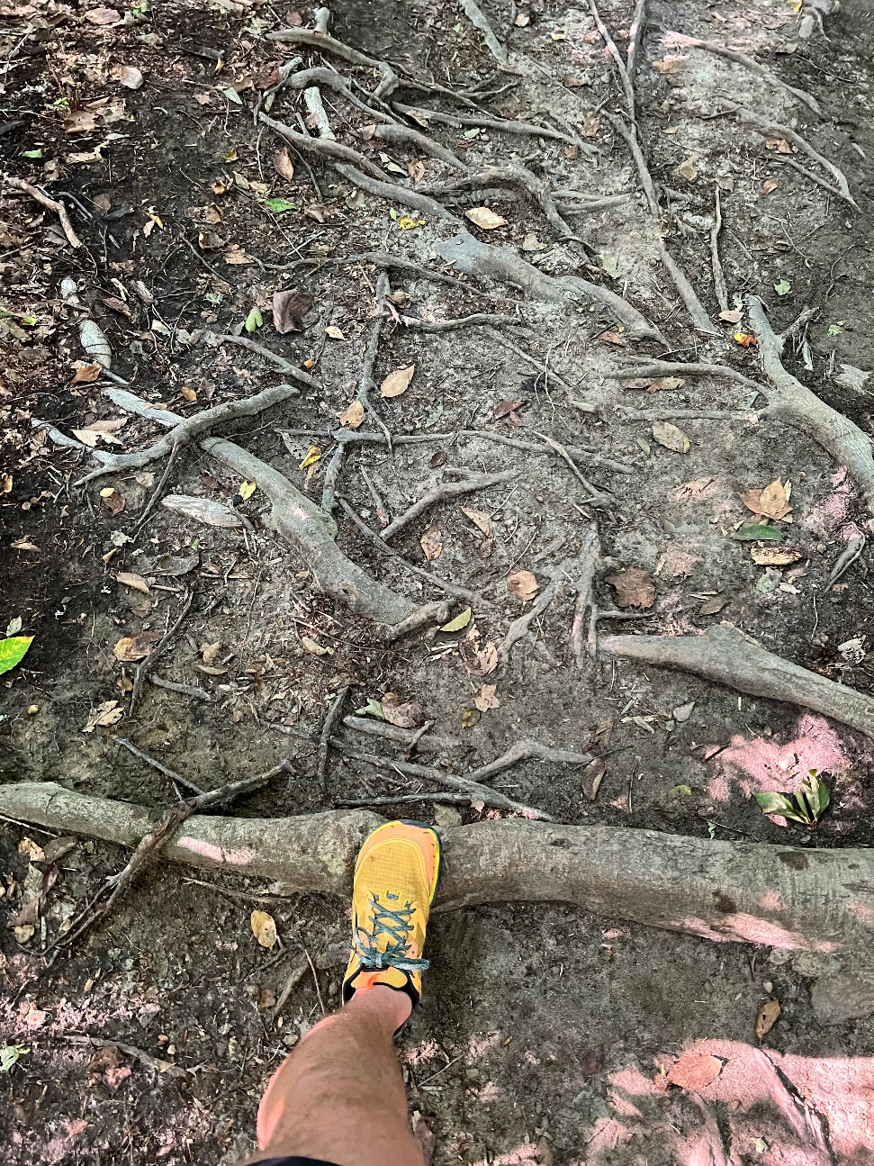

Slide 3
Active Listening
Active listening starts with a good question
Enter the conversation without having any of the answers
Try your best not to analyze the story as it is being told
It is ok and encouraged to ask more questions
Notes:
Mission Support is one major way that we express that we are church together, investing in ministry beyond our congregations and communities. Sharing in each other’s story.
67% of the churchwide budget comes from Mission Support sharing. Mission Support gives ministries of the churchwide organization room to continue to focus on mission and ministry.

Slide 4
Start with a good question
What can you tell me about your congregation?
Or
When you think about your congregation what brings you joy?
Notes:
Mission Support is one major way that we express that we are church together, investing in ministry beyond our congregations and communities. Sharing in each other’s story.
67% of the churchwide budget comes from Mission Support sharing. Mission Support gives ministries of the churchwide organization room to continue to focus on mission and ministry.

Slide 5
Start with a good question
What are the ministries of your congregation?
Or
How do you believe your congregation is making a difference?
Notes:
Mission Support is one major way that we express that we are church together, investing in ministry beyond our congregations and communities. Sharing in each other’s story.
67% of the churchwide budget comes from Mission Support sharing. Mission Support gives ministries of the churchwide organization room to continue to focus on mission and ministry.

Slide 6
Start with a good question
What does your ministry do?
Or
From your perspective in what positive ways has your ministry made an impact on your community?
Notes:
Mission Support is one major way that we express that we are church together, investing in ministry beyond our congregations and communities. Sharing in each other’s story.
67% of the churchwide budget comes from Mission Support sharing. Mission Support gives ministries of the churchwide organization room to continue to focus on mission and ministry.

Slide 7
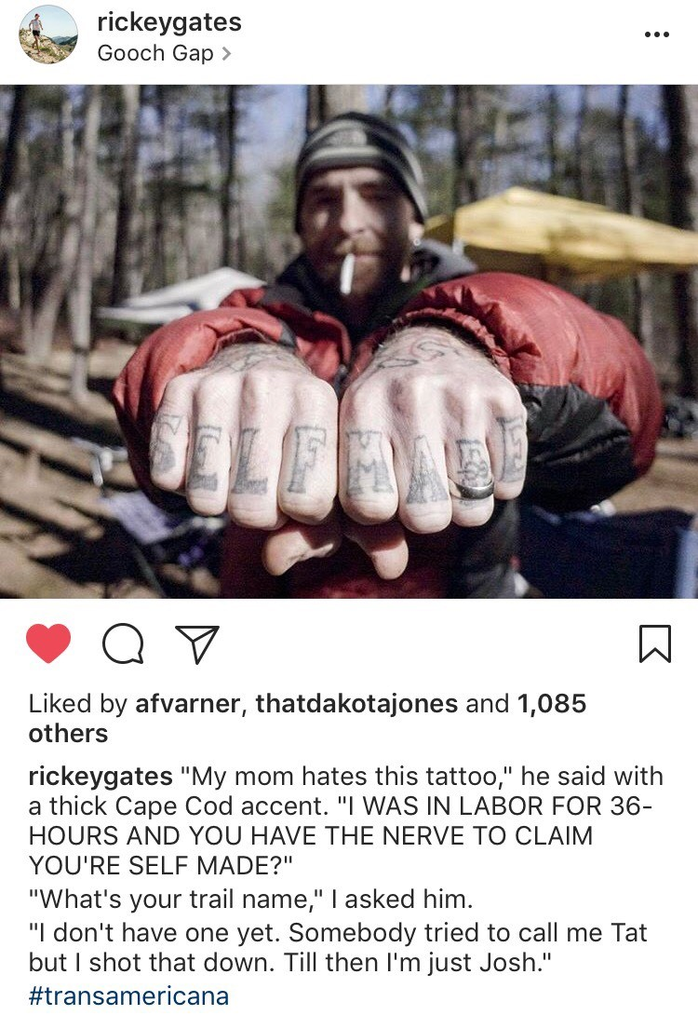
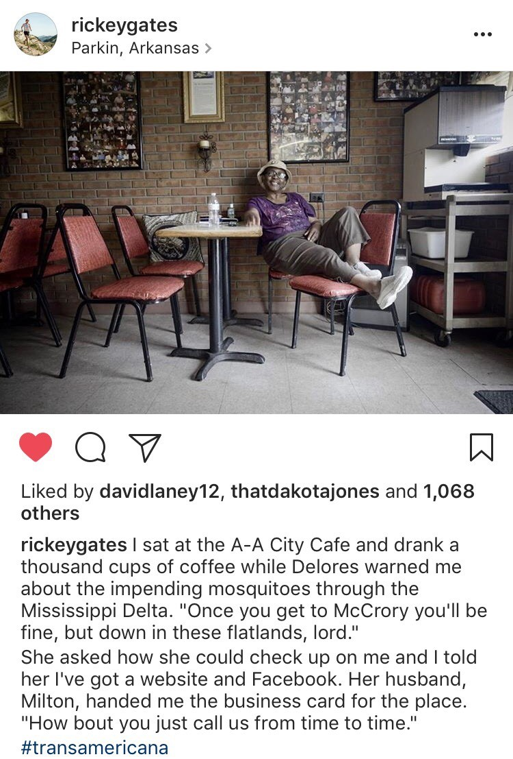
Active listening allows us to meet people where they are

Slide 8
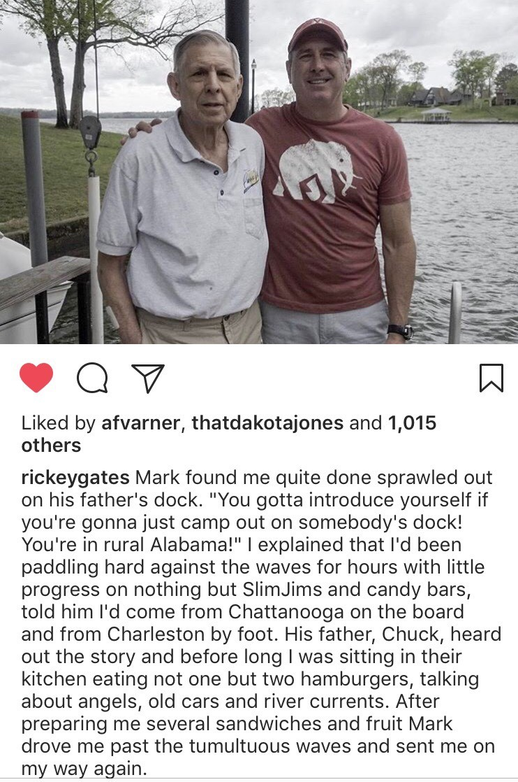
When we meet people where they are, we get to hear the story from their perspective and how they fit into it

Slide 9
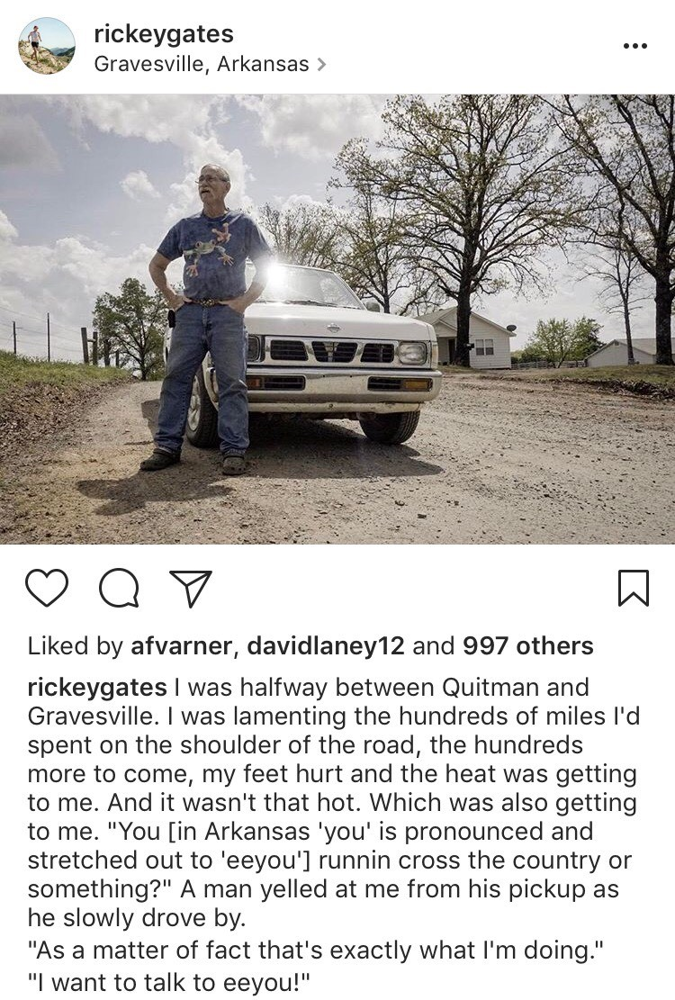
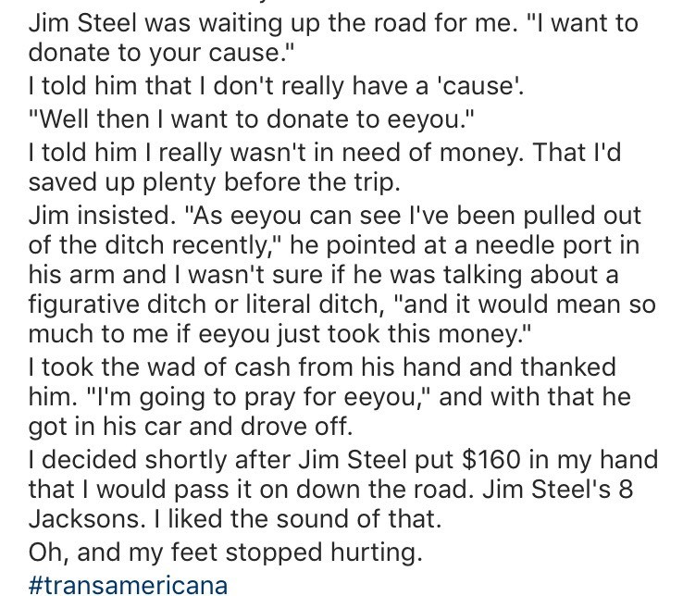
We get to hear how the story impacts the community AND the storyteller

Slide 10
Active listening helps to remind people that we are all storytellers and we all have a story to tell!

