Slide 1

Narrative Spending Plan Step-by-Step
“You can do it!”-Pr. Tim Brown

Slide 2
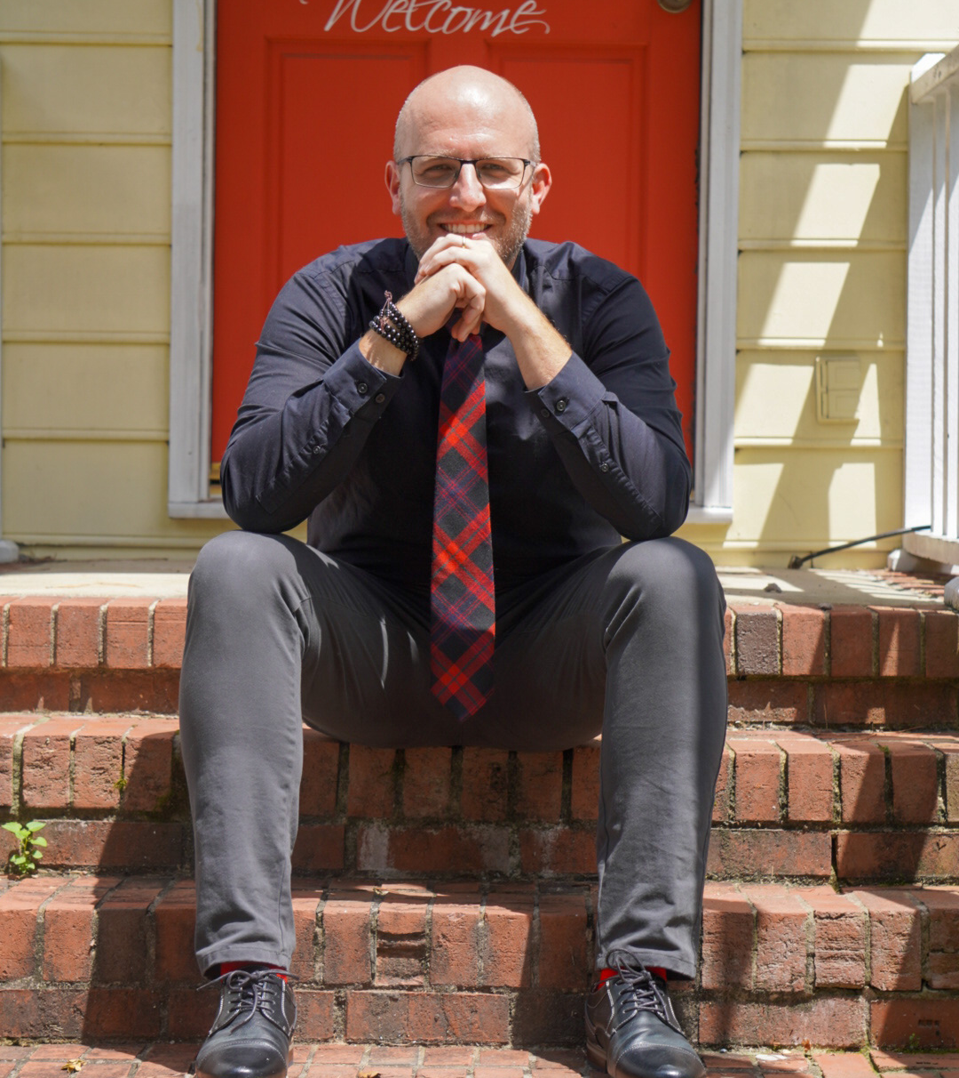
Tim.brown@elca.org
Husband and Dad
Accidental Fundraiser
Director of Congregational Stewardship for the ELCA
Coffee Drinker
Curious about Generosity

Slide 3

Step 1
Be Clear On Why You’re Doing a Narrative Spending Plan
Narrative spending plans tell the QUALITATIVE story, not just a QUANTITATIVE story
Narrative spending plans are honest about impact, not just “cost”
Narrative spending plans don’t hide costs, they reveal the mission priorities
Narrative spending plans are future-oriented.
“Narrative spending plans are a ministry snapshot for a world in need of pictures of impact and hope.”

Slide 4

Step 2
“What do you do?” –Anyone at a Cocktail Party
Decide your areas of impact.
Worship, Learning, Service?
Caring, Outreach, Praise, Education?
Grace, Peace, Hope, Love?
Faith Formation, Service to the World, Love of God?

Slide 5
Step 3
Have Your Line-Item Spending Plans Ready, and Be Ready to Split It Up With Your Areas of Impact In Mind
Color-coding can be your friend here
Some areas will need to be split between areas of impact (looking at you, mission outpost!)
Be as precise as you can without getting lost in the weeds
Highlight new mission-oriented goals!
“Show your work.”-Ms. Keller, My 4th Grade Teacher

Slide 6
Comparison
St. Jude by the Butterfly Preserve
Line Items
Ministry Category
Youth & Family Ministry
6005 Sunday School
6100 Confirmation Ministry
  6101 Curriculum
  6102 Confirmation Camp
6200 Bibles
6300 Service events
Worship
7301 Communion Supplies
7302 Copyrights
7303 Organ Maintenance
Partner Ministries
Faith Formation
Worship
Care & Outreach
Ministries Support

Slide 7
Step 4
“And just what were you doing?!”-My mother to. my high-school self
For Staff (Including Pastor) Do A Time Audit
Ask your staff to audit their time and figure out how they split up their ministry across your impact areas…and you do the same. Rough estimations are ok!

Slide 8
Ex: Staff ministry area breakdown
Line Item | Partner Ministries | Faith Formation | Worship | Care and Outreach | Ministries Support
% that serves one Ministry Area: | 59.3% | 9.0% | 29.4% | 1.3% | 1.0%
Pastor Sally | 25% | 15% | 20% | 5% | 35%
Pastor Joe | 15% | 25% | 20% | 25% | 15%
Parish Life Dir. | 32% | 25% | 3% | 22% | 18%
Admin. Assist. | 9% | 15% | 15% | 20% | 41%
Custodian | 35% | 28% | 22% | 2% | 13%
Building Use | 32% | 25.9% | 19.9% | 2.2% | 20%
% of Total | 37.9% | 19.2% | 17.9% | 7.0% | 18.0%

Slide 9
Step 5
Total Up Your Impact Costs
Your impact counts (literally).
Use your congregation members to help!
“You made a difference”-my math teacher during a unit on subtraction

Slide 10
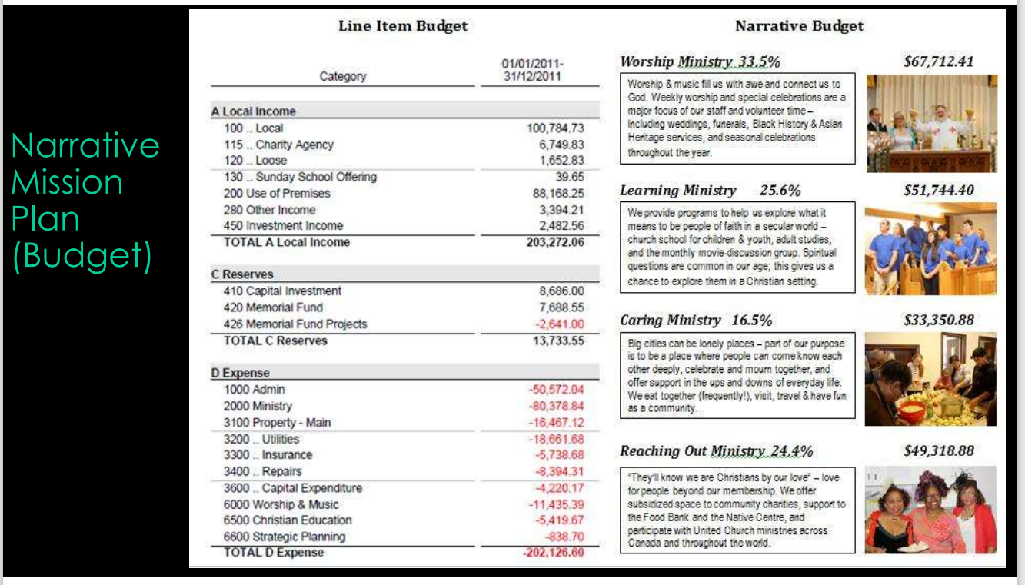
How This Might Look…
It is OK to be Approximate!

Slide 11
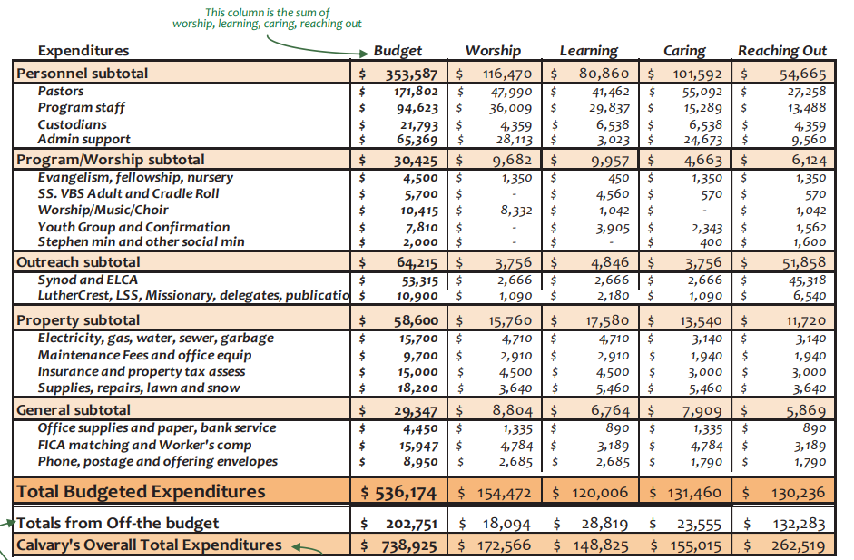
How This Might Look…
It is OK to be Approximate!

Slide 12
Step 6
Tell the Whole Story
Charts provide a visual aid in understanding your impact
Real Quotes of Real Impact
This is What Truly Matters
Use Canva, Word, or whatever medium works for your content, and have it available!
“Tell the truth, the whole truth, and nothing but the truth.”-Judges (not the book in the Bible)

Slide 13
How Does Our Mission Plan Change Lives?

Slide 14

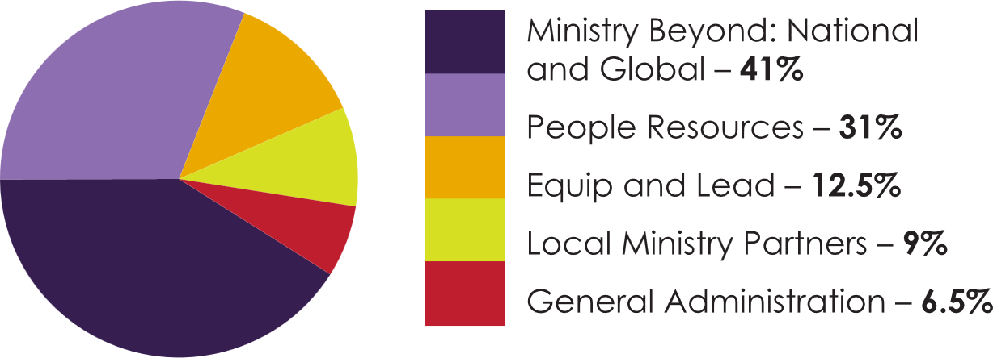

Slide 15
How Does Our Mission Plan Change Lives?
Take a Look-See

Slide 16

Missional Budget: 2014
Growing a Christ-Centered Community through Life-Changing Service by:
*Embracing all of God’s Children.
On Sunday mornings we gather together around God’s Word and the Eucharist to give back to God, take a moment to refocus us for the journey ahead, and be impacted by the Word through sermons, scripture readings, and spiritual songs. Our choirs range welcome everyone who wants to praise God. Our worship leadership involve the aged, the young, and everyone of any ability. We send Each year over 120 regular worship services happen at LMC, with over 240 people gathering each week (on average over the whole year). Our music program involves children, adults, and a variety of instruments and bells. Our worship is sustained by over 100 volunteers each year. And our special liturgies: baptisms, funerals, marriages connect people’s life passages with the God who sees them through. The sermons are relevant and connect with the life. The music is a mix of historic and modern. In all these ways we strive to connect people back to God each week.
Budget Cost: $152,213.
(included here are portions of salaries, building expenses, and administrative costs)

Slide 17
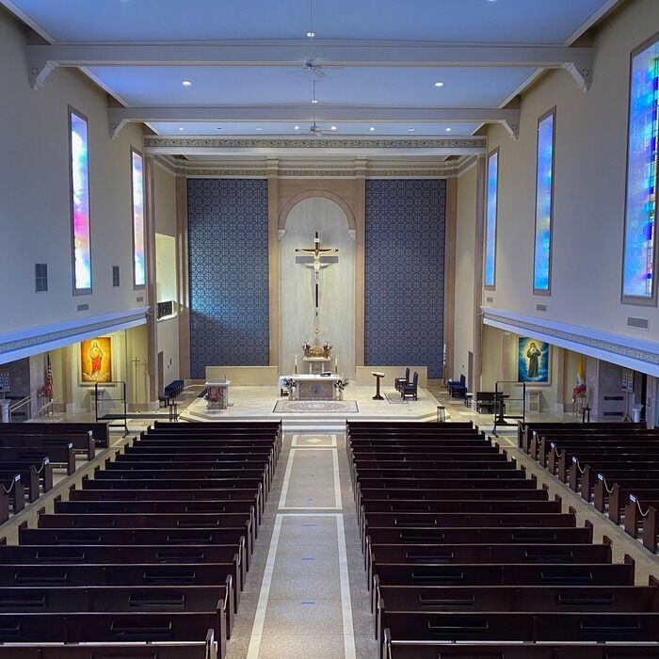
Missional Budget: 2014
Growing a Christ-Centered Community through Life-Changing Service by:
*Providing a community space and a place for all of the community.
We are blessed to be on the corner of Wilson and Campbell. We want to be the heart of this community and welcome others into the space with radical hospitality. Our One Stop Wednesday meals have taken off, with an average of 60 coming each week to eat together and share with one another. The Wellness Initiative continues to grow and make our space a place of healing for body and soul. Our Adult Education offerings have not only expanded, but have grown! Our Sunday School and Youth Group are double what they were two years ago, encouraging us to solidify ministry positions, both paid and volunteer. We have more plans for more retreats, more opportunities for intense spiritual growth, and more opportunities to show one another and the city of Chicago the gracious hospitality of God.
Budget Cost: $155,000.
(included here are portions of salaries, building expenses, utilities, and administrative costs)

Slide 18

Missional Budget: 2014
Growing a Christ-Centered Community through Life-Changing Service by:
*Serving God’s people with generosity and grace.
Each year LMC plans to give at least 8% of the budget away…and it increases yearly. In actuality we end up giving around 12% of our budget away through planned gifts, Lutheran World Relief, and tithes off of generous bequests and gifts. We partner with the Lincoln Square Friendship Center, Refugee One, The Wellness Initiative, The Night Ministry, Lutheran Disaster Response, Urban Acacia, and a number of other organizations to help them fulfill God’s mission in the world. WE provide staff to help with advocacy and mission. We visit those who cannot be with us on Sunday mornings, keeping them as connected to the community as possible. Our pastor meets with civic leaders and those in crisis to help bring the peace of God to tense situations. Our building houses groups and organizations for free as they seek to live out God’s mission.
Budget Cost: $92,230.
(included here are portions of salaries, benevolence to the ELCA, Night Ministry, and LSFC, utility expenses, and administrative costs)

Slide 19
Pro-Tip
“Smiley, happy people holding hands…”
Show the Story in Images
Use real photos of real ministry happening…unlike this presentation which used stock photos of nicely manicured hands. Photos of your people in action help tell the story in familiar ways!

Slide 20
Step 7
Highlight What You’re Going to Do!
You can make this a different offering if you want to
Surround it with stories
Make it as exciting as it is
“What’s new?” –My pops when he calls

Slide 21
How Does Our Mission Plan Change Lives?
Take a Look-See

Slide 22
Step 8
Make It Available
Mail
E-Mail
Printed in bulletins
“Is it here?” –My kids looking for Amazon packages

Slide 23




Thank You
Pr. Tim Brown
Director for Congregational Stewardship Support
Tim.brown@elca.org

